Slide 1
ANIMAL ETHICS and GUIDANCE
(AEG)

Slide 2
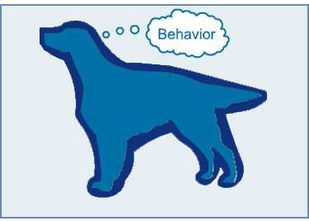

Slide 3
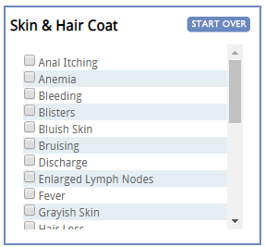
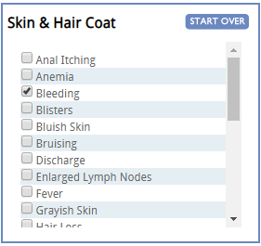

Slide 4
